Slide 1
Virginia ABC Social Media Insights

Slide 2
Spirited Virginia Facebook Audience Insights

Slide 3
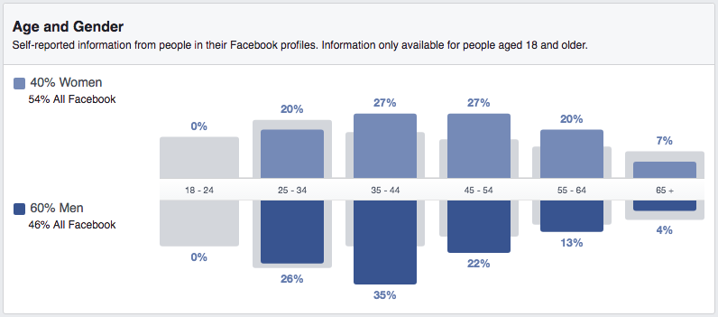
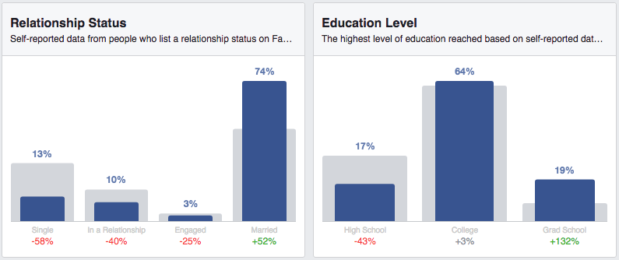
Spirited Virginia Fan Profile: Demographics
Data call-outs:
Younger men are thirstiest for spirit content: Over one-third (37%) of all fans are males, 25-44
Kids are grown, I can finally relax: Women aged 45-64’s interest in Spirited Virginia does not decrease as rapidly as men of the same age
Married and smart: Fans are 52% more likely than the U.S. average to be married, and more likely to have an undergrad or a graduate degree under their belts
Source: Facebook Insights for Spirited Virginia

Slide 4
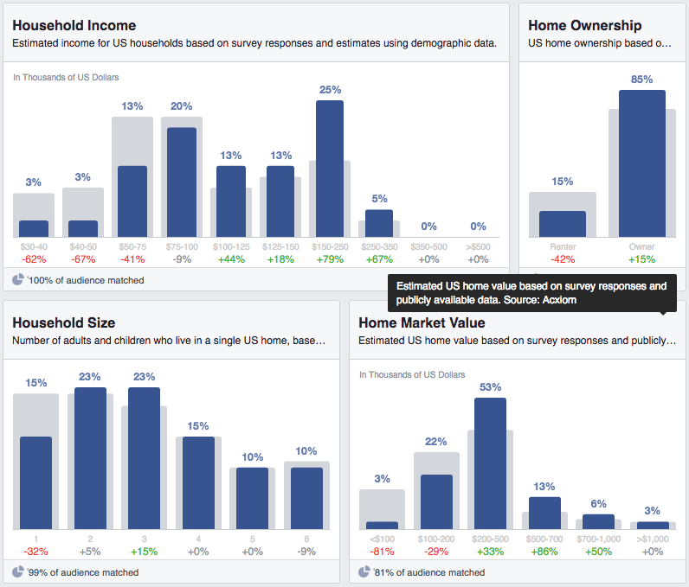
Spirited Virginia Fan Profile: Demographics
Data call-outs (cont.):
Spirits pair well with middle and upper class earners:
One-quarter of all fans have an estimated HHI of $150K-$250K, and over-index on all ranges $100K-$350K
Fans are more likely that the U.S. average to own a home valued at over $200K
Kids make you appreciate a good drink: Spirited Virginia fans are 15% more likely to have at least one child
Source: Facebook Insights for Spirited Virginia

Slide 5
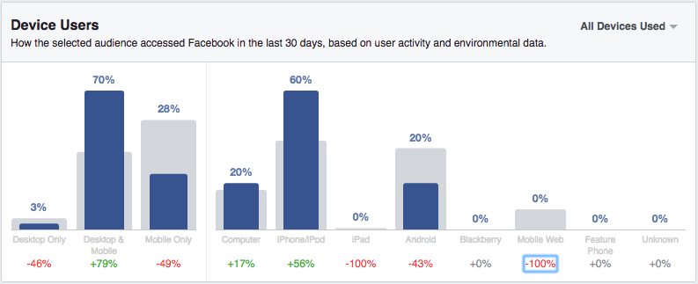
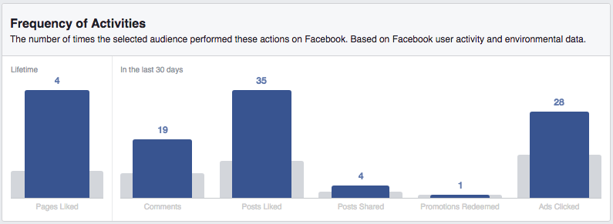
Spirited Virginia Fan Profile: Facebook Usage
Methods of accessing Facebook:
Spirited Virginia fans use Facebook at home and on the go: 70% of fans used both desktop and mobile devices to access Facebook, which is 79% higher than the U.S. average
We should ensure all social content is optimized for the mobile feed: Mobile devices – especially iphones – are the most commonly used methods of access
How do they Facebook?
Spirited Virginia fans are more enthusiastic users than the norm: They are more likely to comment, like, share, and even click on ads
Source: Facebook Insights for Spirited Virginia

Slide 6
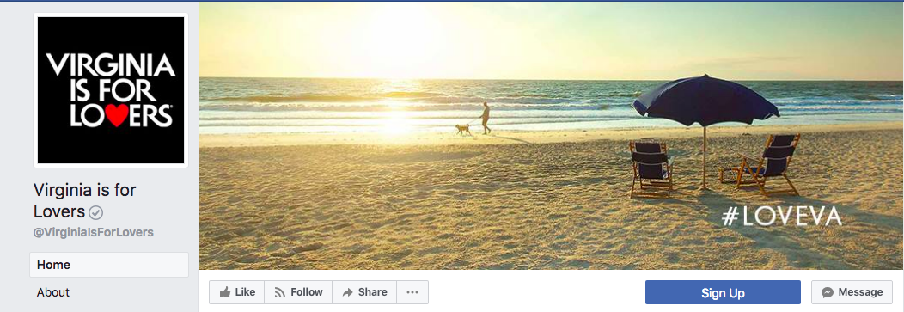
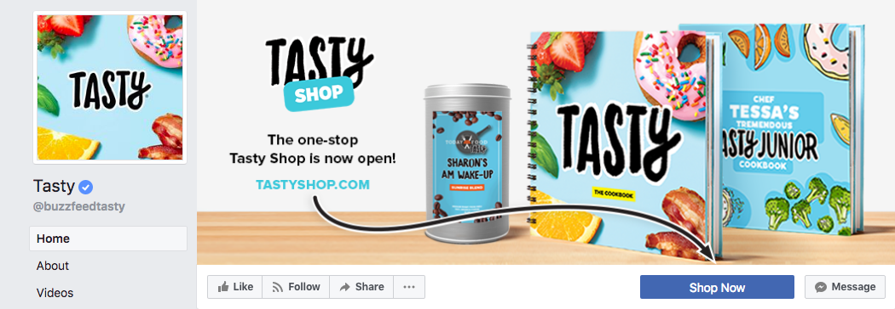
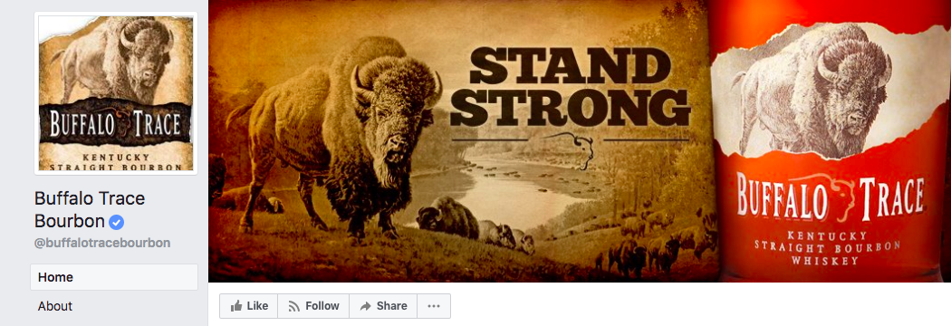
Spirited Virginia Fan Profile: Audience Overlap
Top options for Facebook content inspiration and partnerships:
Virginia is for Lovers: 1.3K of Spirited Virginia’s fans like this page, which has 870,000 fans
Tasty: Nearly 1,000 of Spirited Virginia’s fans like this page, which has 87.5 million fans
Buffalo Trace Bourbon: Almost 700 of Spirited Virginia’s fans like this page, which has 677,000 fans
Source: Facebook Insights for Spirited Virginia

Slide 7
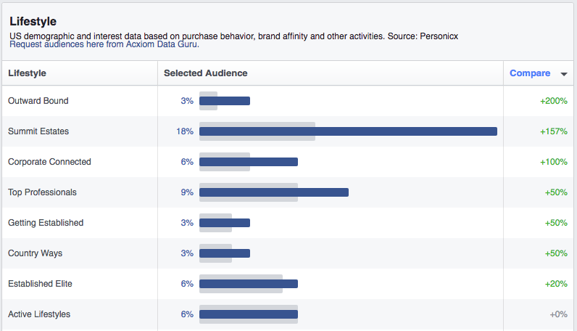
Spirited Virginia Fan Profile: Top Lifestyle Segments
Summit Estates
These families are enjoying the good life: luxury travel, entertainment, and every kind of consumption are within easy reach
Top Professionals
One of the best-educated clusters, these families shop at upscale stores, spend time feathering their nest, and adhere to regular fitness programs
Outward Bound
People with middle-income, rural households, most without children, but a few with some toddlers, preschool and grade school children. Home ownership dominates this cluster
Source: Facebook Insights for Spirited Virginia

Slide 8
Insights From Social Listening

Slide 9

Twitter

Slide 10
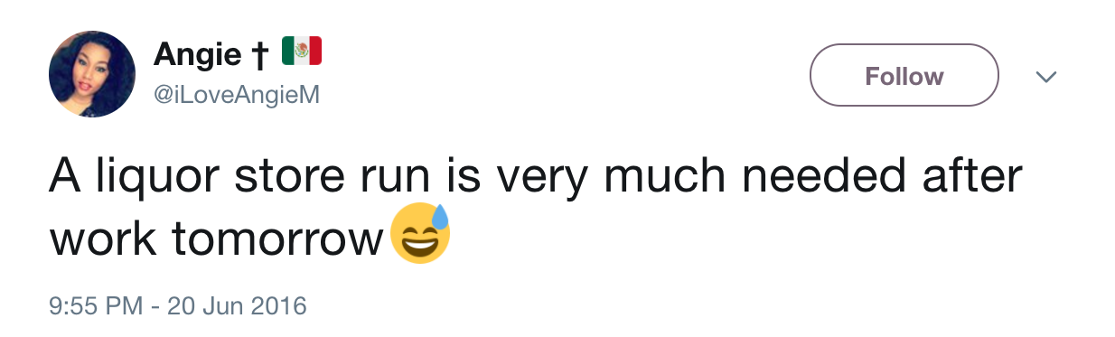
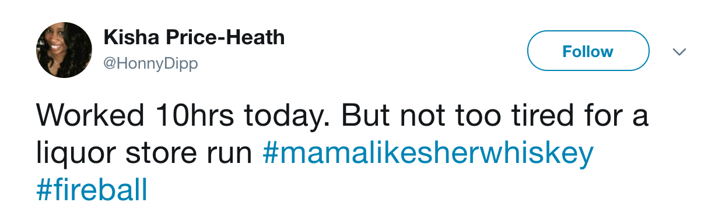
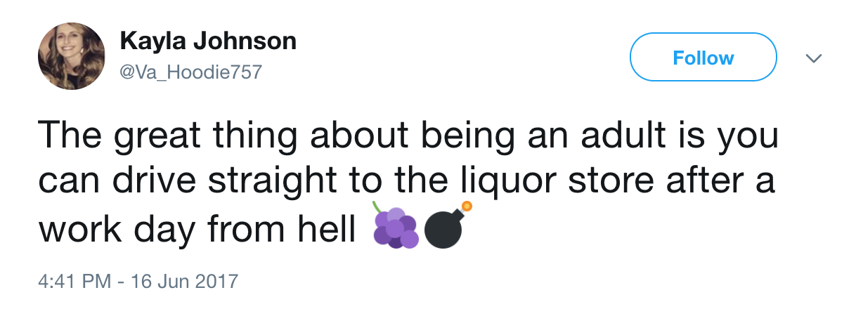
Viewing the Liquor Store as a Noteworthy Destination
Supplies to De-stress
The liquor store is a place that customers look forward to visiting after a stressful day
Source: Sysomos

Slide 11
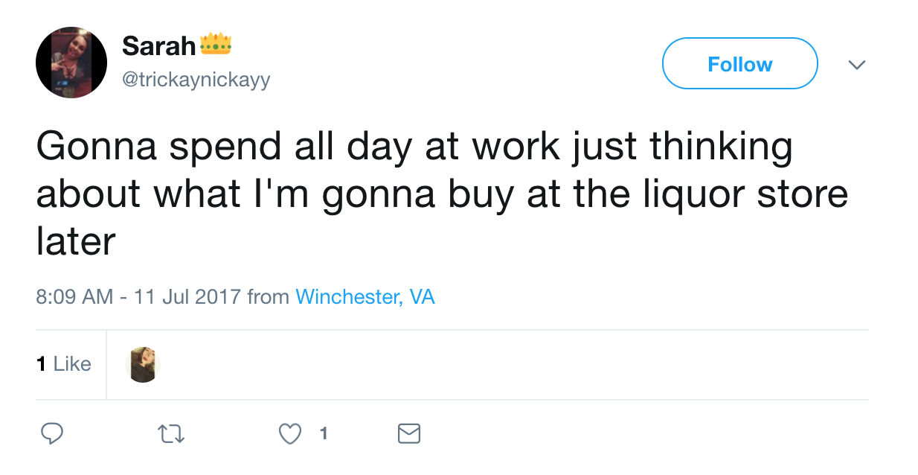
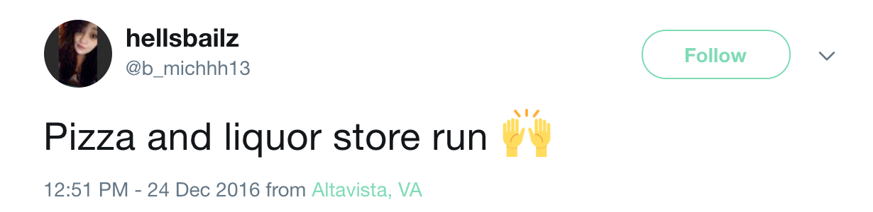
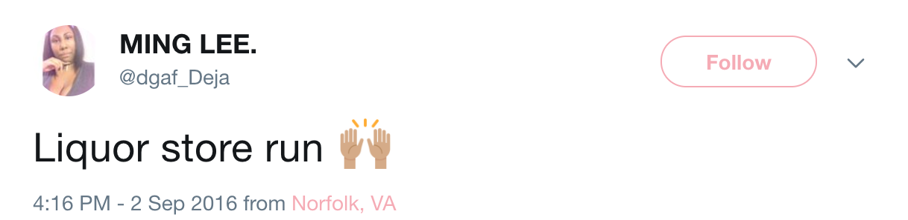
Viewing the Liquor Store as a Noteworthy Destination
The extra trip isn’t always a chore
An errand that some anticipate with excitement
Source: Sysomos

Slide 12
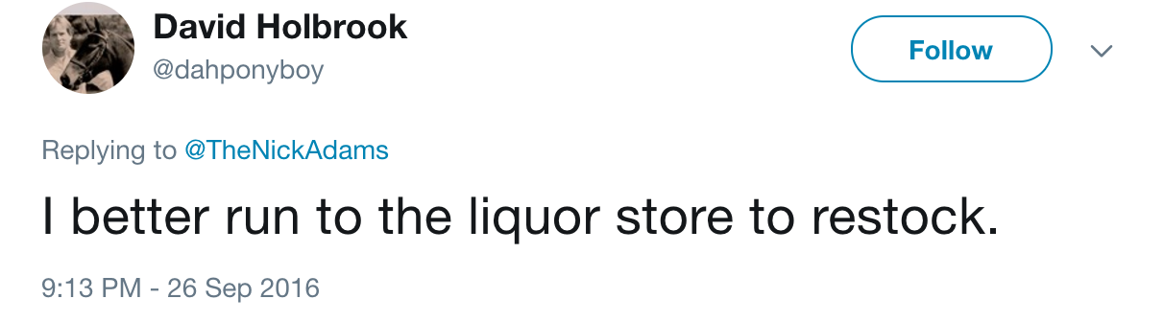
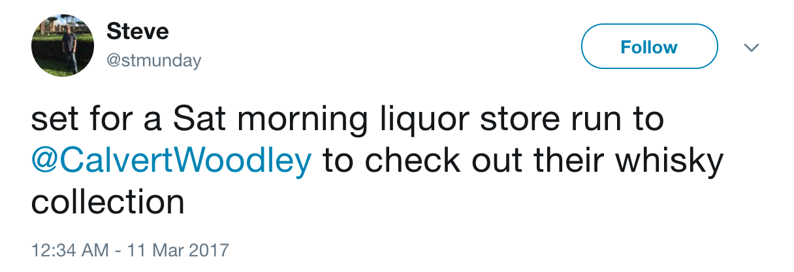
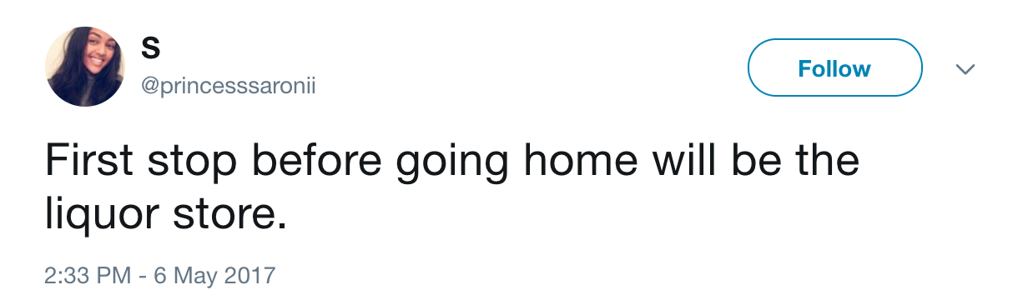
Viewing the Liquor Store as a Noteworthy Destination
Keeping followers in the know
When they are going or have gone to make a purchase
What they are going to look for or planning on purchasing
Source: Sysomos

Slide 13
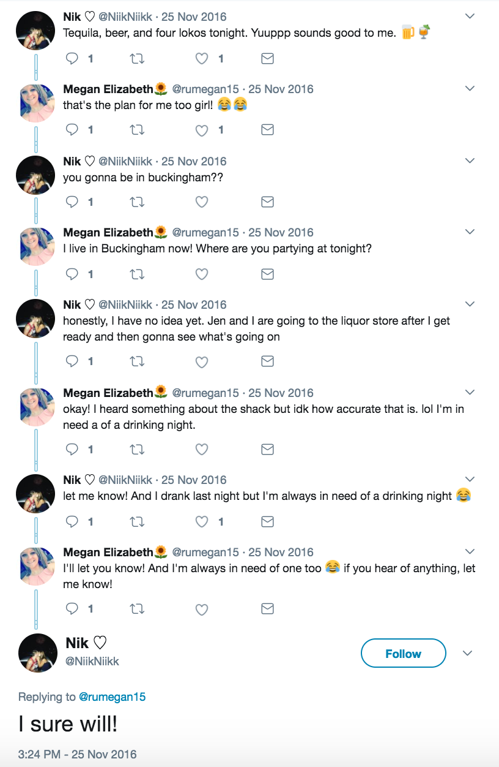
Making Plans with Friends
Discussions about:
What to do
Where to go
What will be consumed
Source: Sysomos

Slide 14
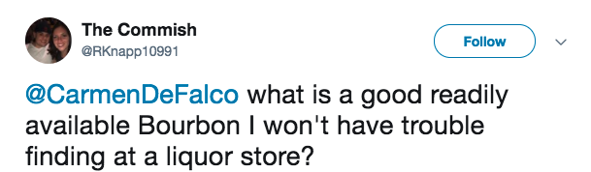
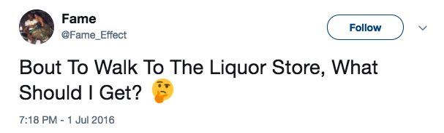
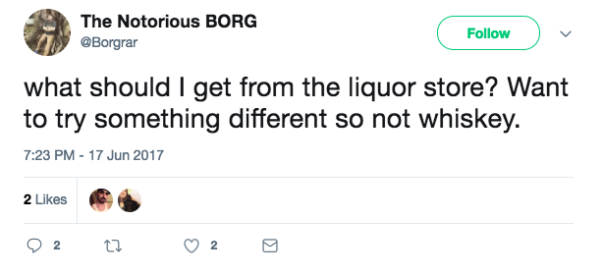
Crowdsourcing Information
Ideas of what to purchase
Asking for specific brands and/or types of liquor to try or purchase
Giving and receiving recommendations based upon what consumers know they enjoy
Source: Sysomos

Slide 15
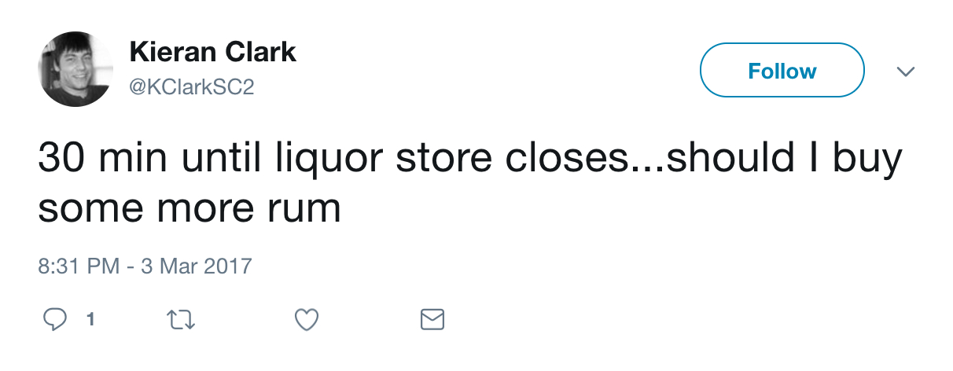
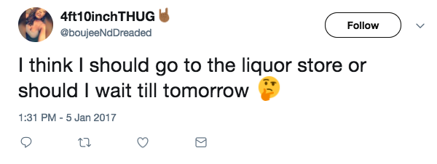
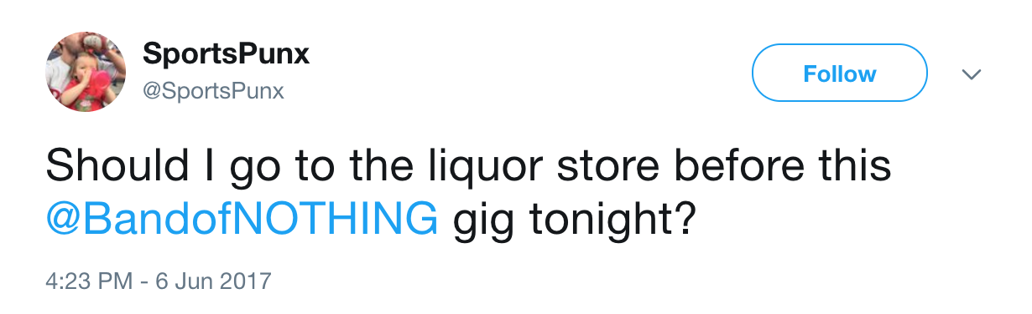
Crowdsourcing Information
When to go shopping
Verification for making a purchase at a certain time
Source: Sysomos

Slide 16
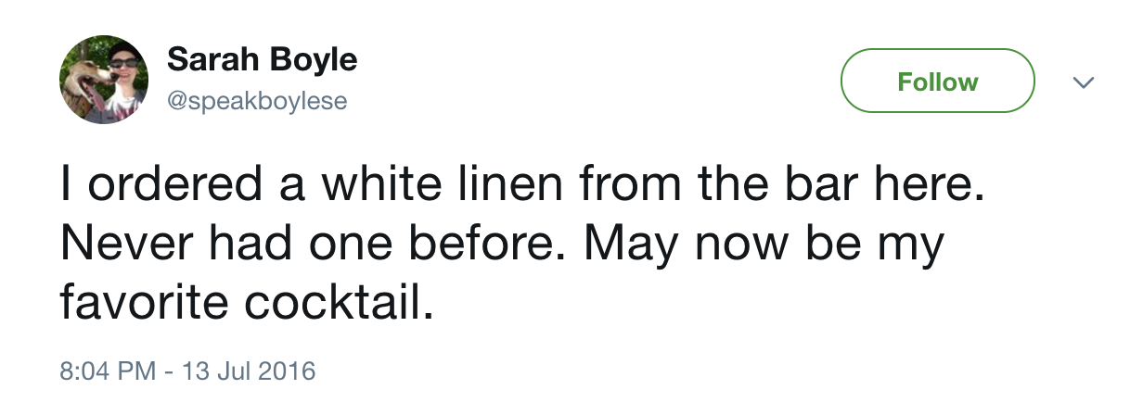
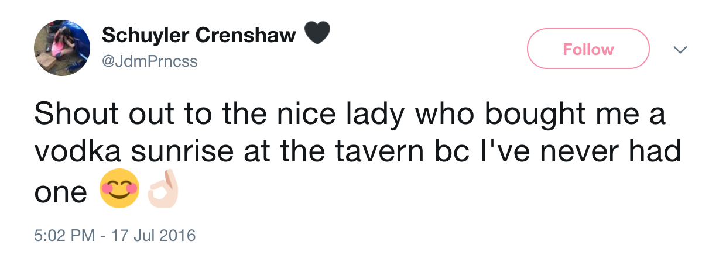
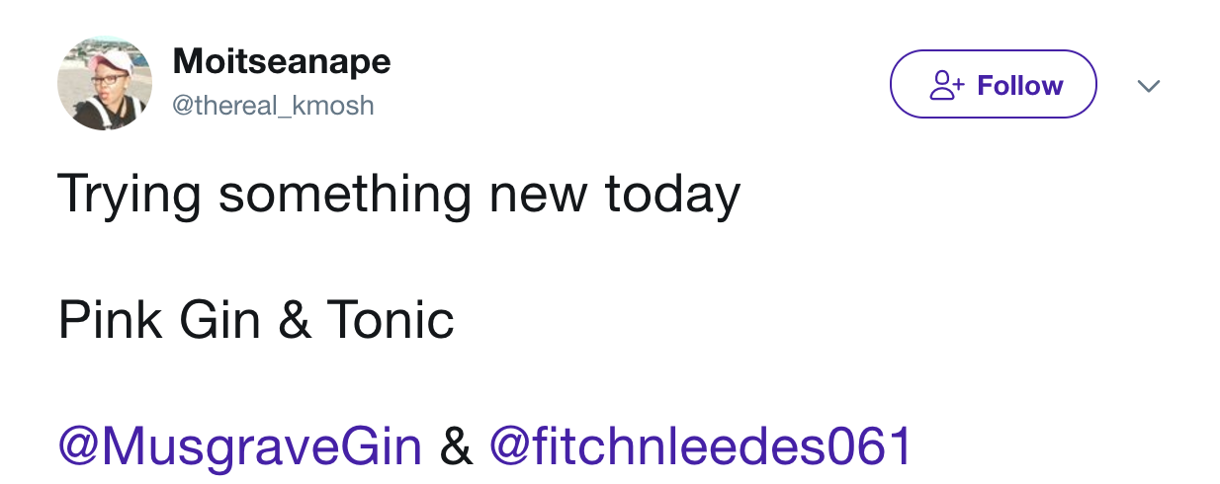
Consumers Broadening Their Horizons of Spirit Consumption
Chatter within these posts include:
Trying different spirits
Trying new cocktails
Trying other recipes
In general, the posts are of positive experiences when venturing beyond the users’ usual spirit choices.
Source: Sysomos
27.5K Twitter Results
Timeframe: the past 12 months
Keywords/Phrases Include: trying new, new cocktail, first time having, +spirit types

Slide 17
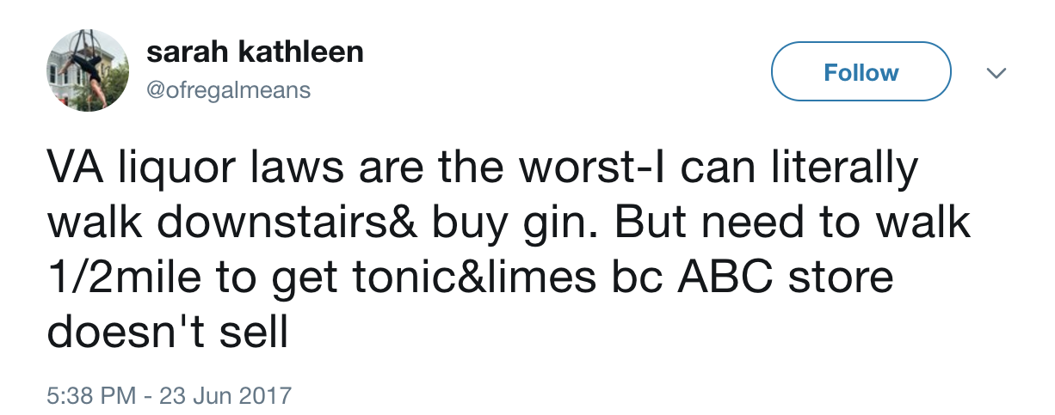
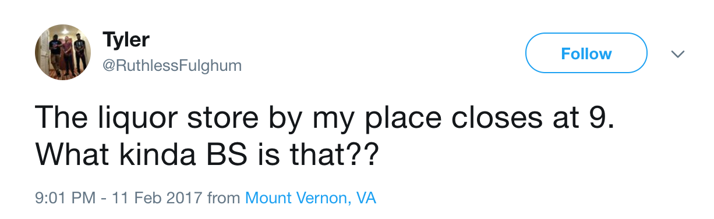
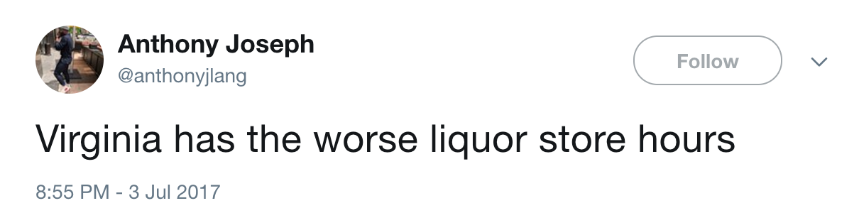
The Virginia ABC Store Experience
Inconvenience
Stores not offering the supplementary items consumers would need to complete a cocktail (i.e. limes, tonic, soda, etc.)
Closing before consumers are able to get to the store
Source: Sysomos

Slide 18


Instagram

Slide 19
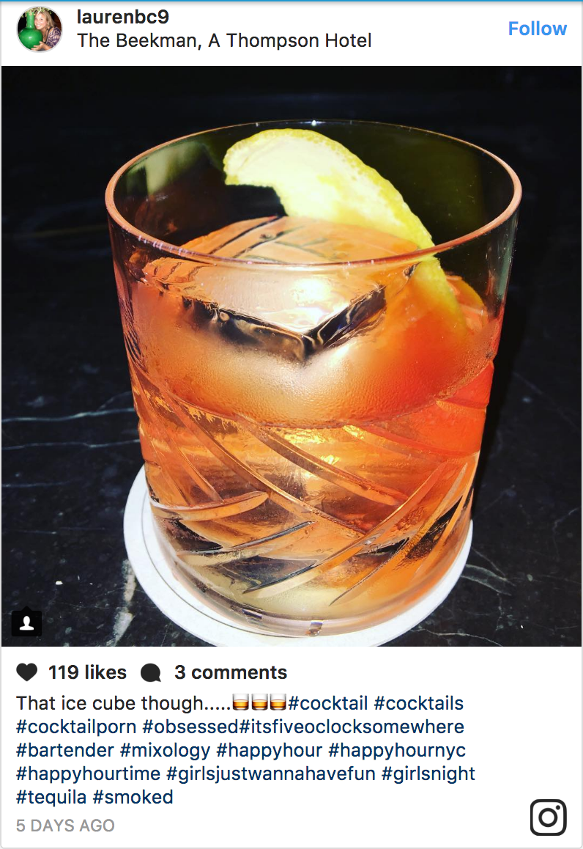
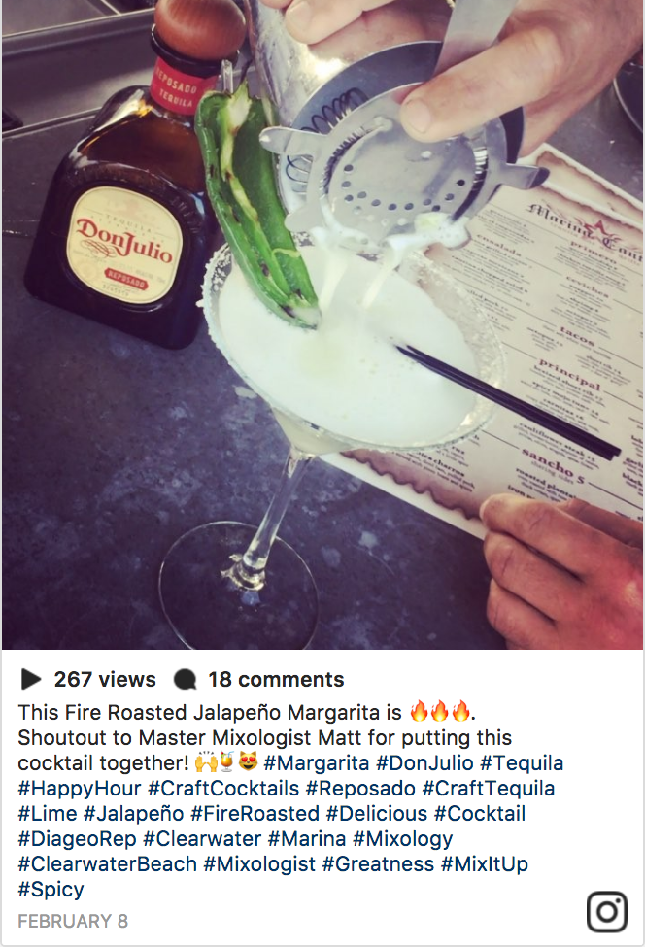
Getting Creative with Cocktails
Appreciation for the art
Cocktails are more special than a bottle of beer or a glass of wine, the attention to detail is displayed and shown off
Noting specific garnishes and ingredients is popular
Source: Sysomos; 48,408 Instagram Results

Slide 20
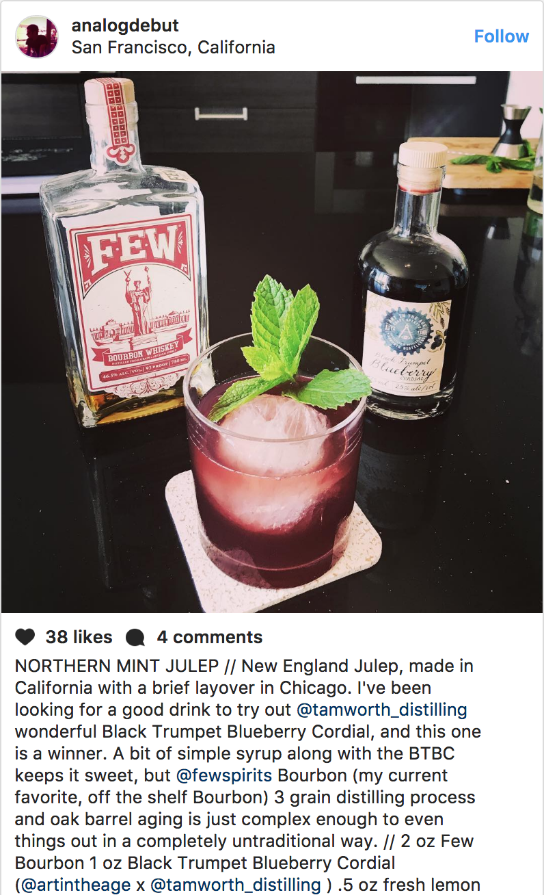
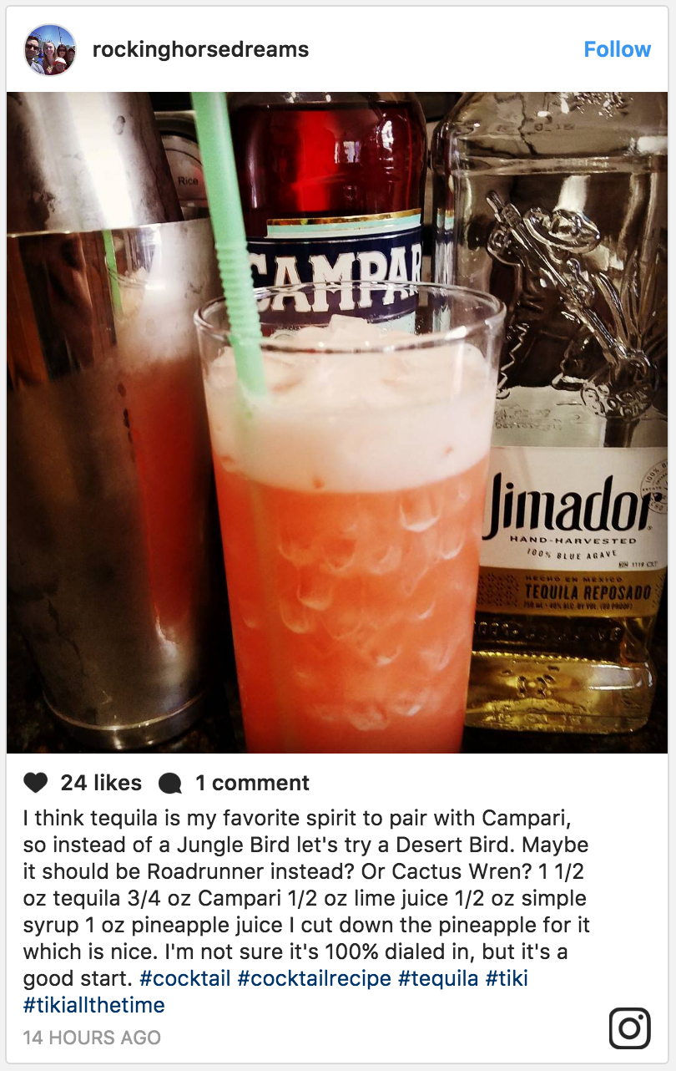
Getting Creative with Cocktails
Handcrafted at Home
At-home mixology is very popular – consumers proudly post their experiments
Sharing recipes and tips
Source: Sysomos; 48,408 Instagram Results

Slide 21
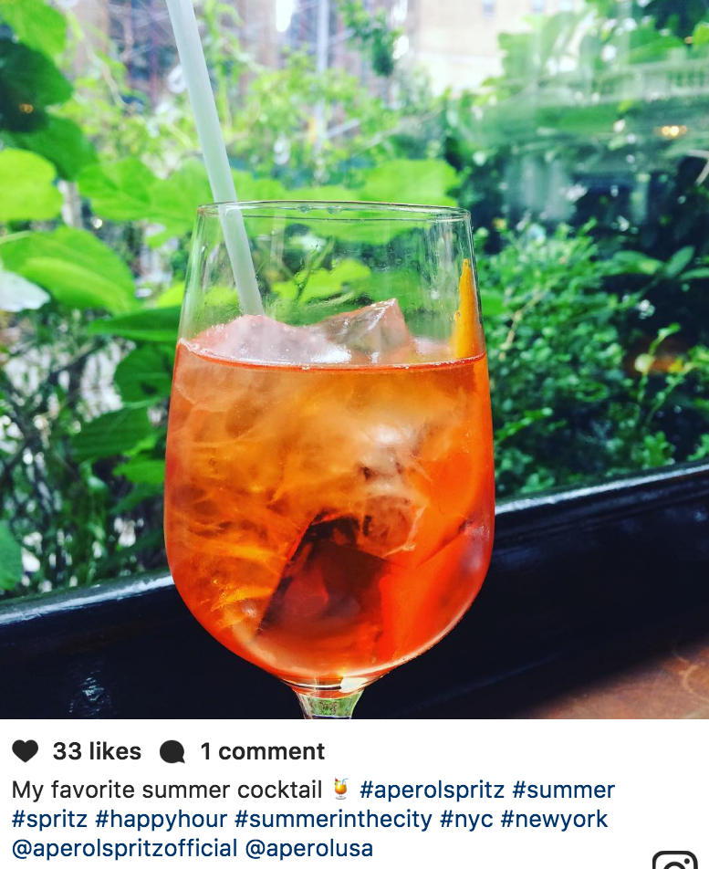
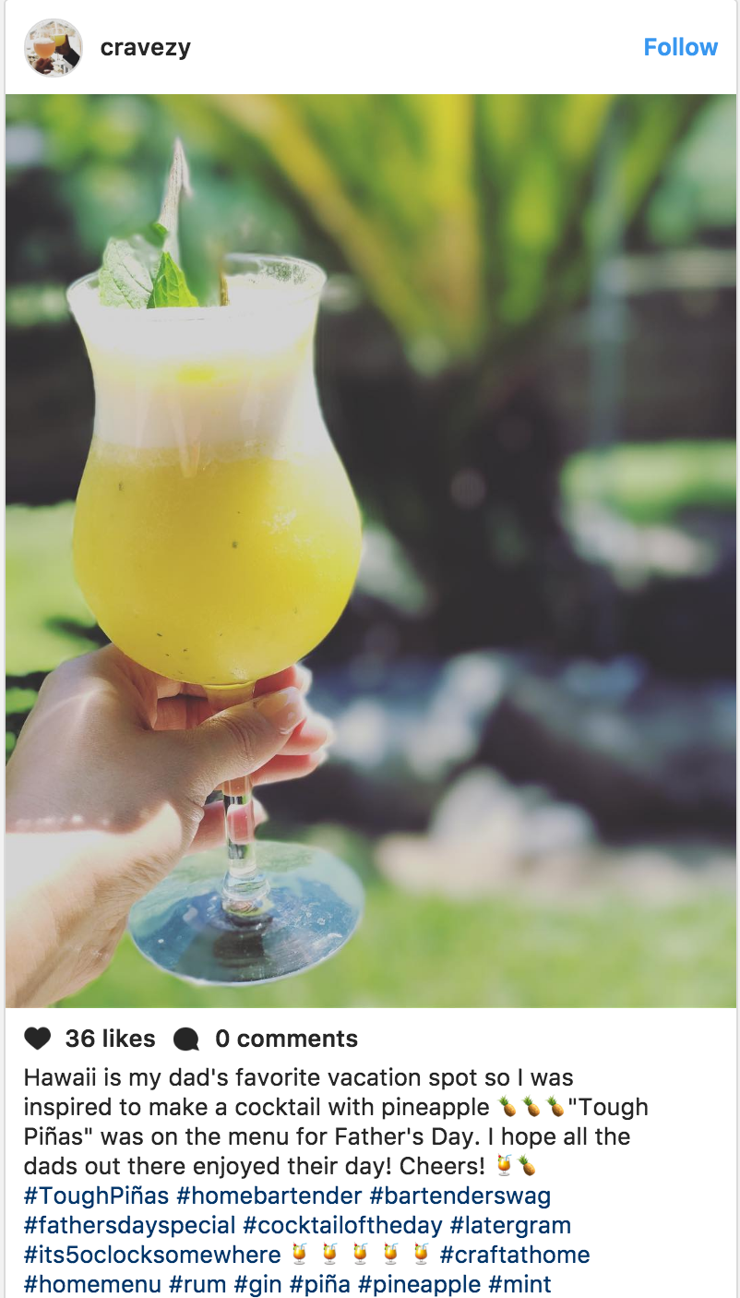
Showcasing Their Taste
Sharing their experiences
Homemade libations
Restaurant or bar cocktails
Specific locations or settings
Source: Sysomos; 48,408 Instagram Results

Slide 22
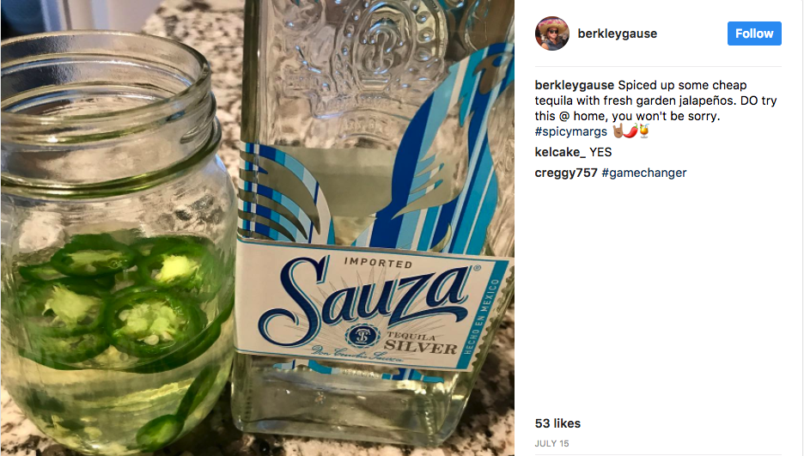
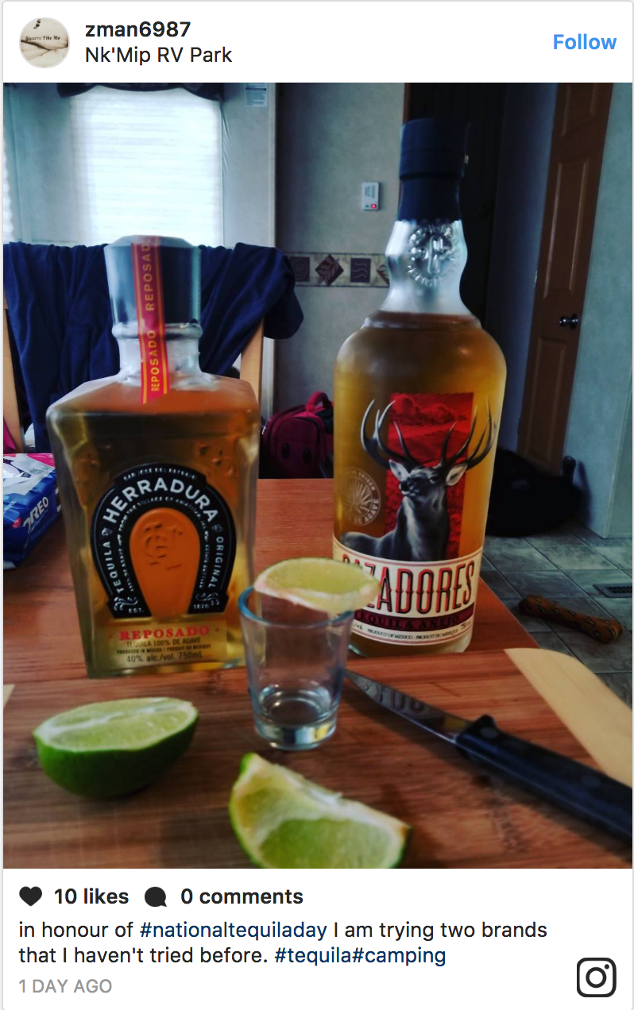
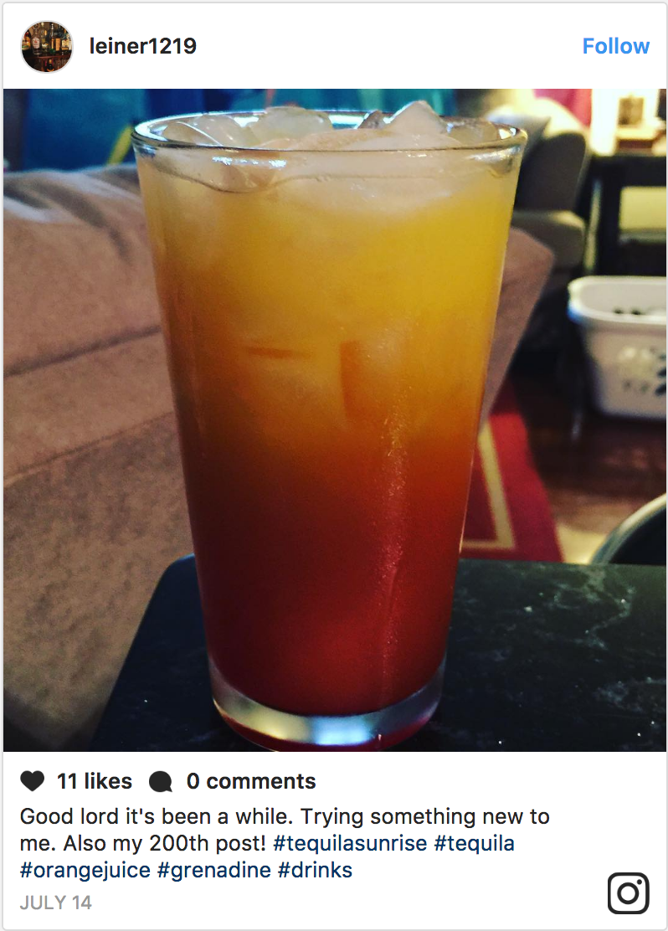
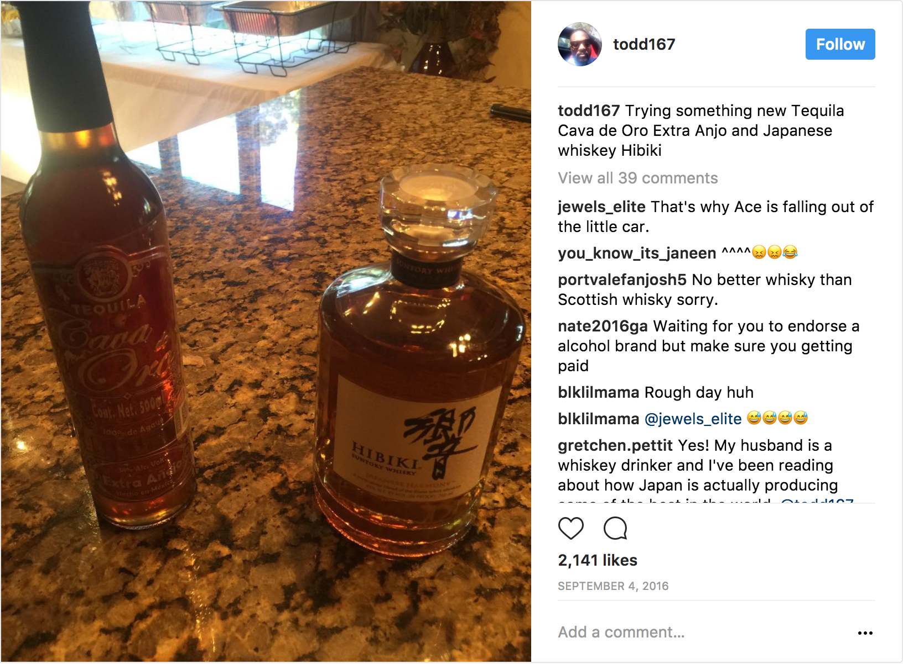
Consumers Are Not Afraid to Mix Up Their Routine and Experiment
Posts of experimentation include:
Buying new spirits and brands
Trying new mixers
Adding new garnishes
As is the case of posts surrounding mixology on this platform, many of these posts are taken at home.
Source: Sysomos
4.2K Instagram Results
Timeframe: the past 12 months
Keywords/Phrases Include: trying new, new cocktail, first time having, +spirit types

Slide 23

Facebook

Slide 24
Social listening on Facebook is limited to Virginia ABC properties.

Slide 25
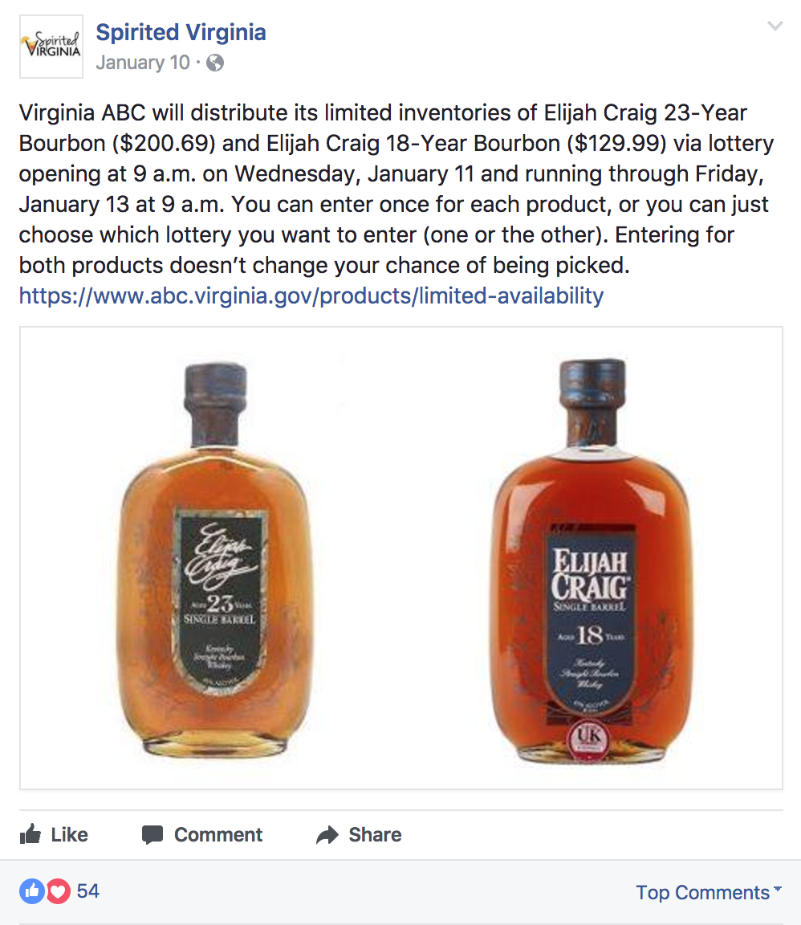
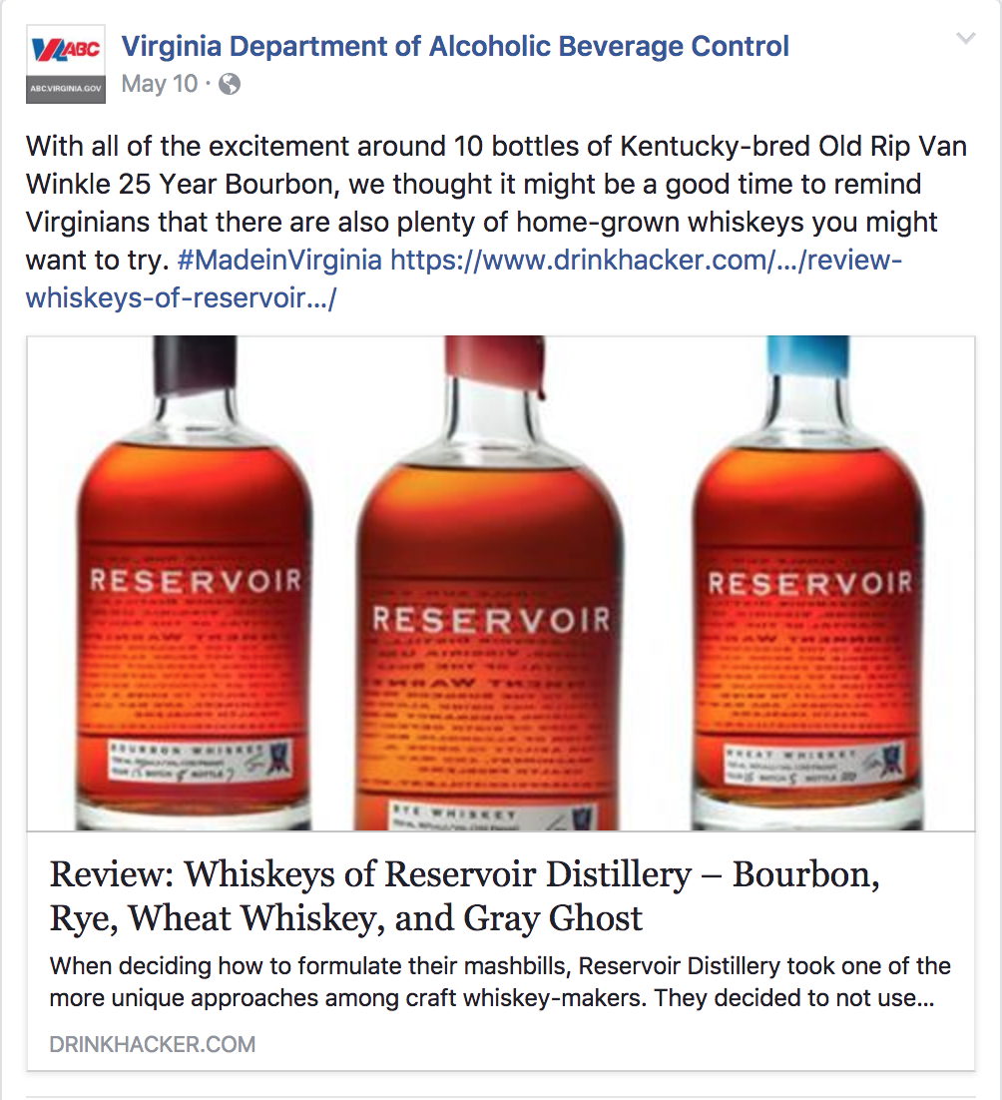
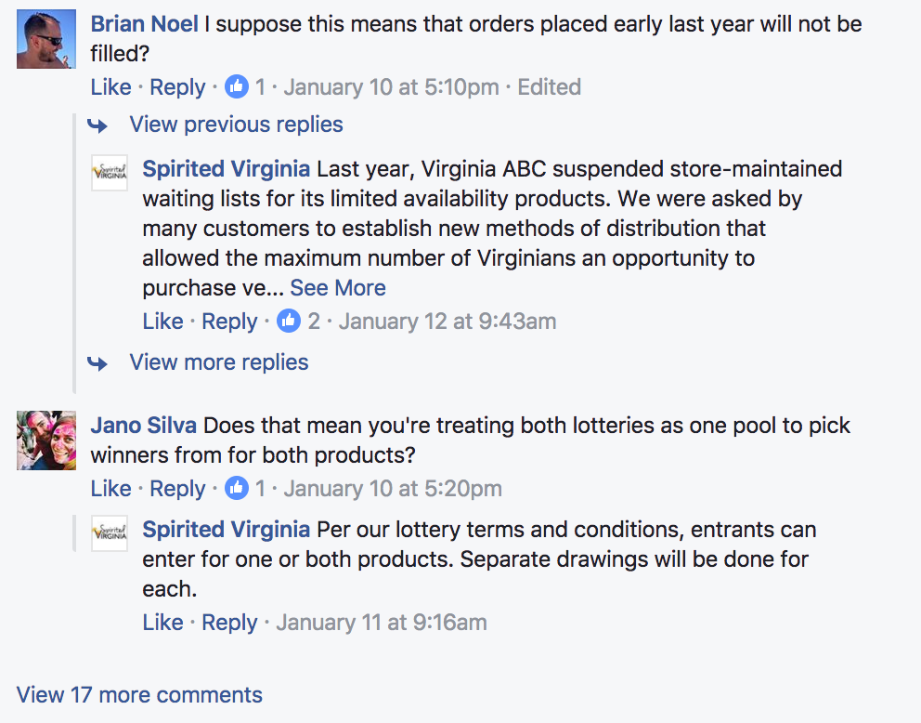
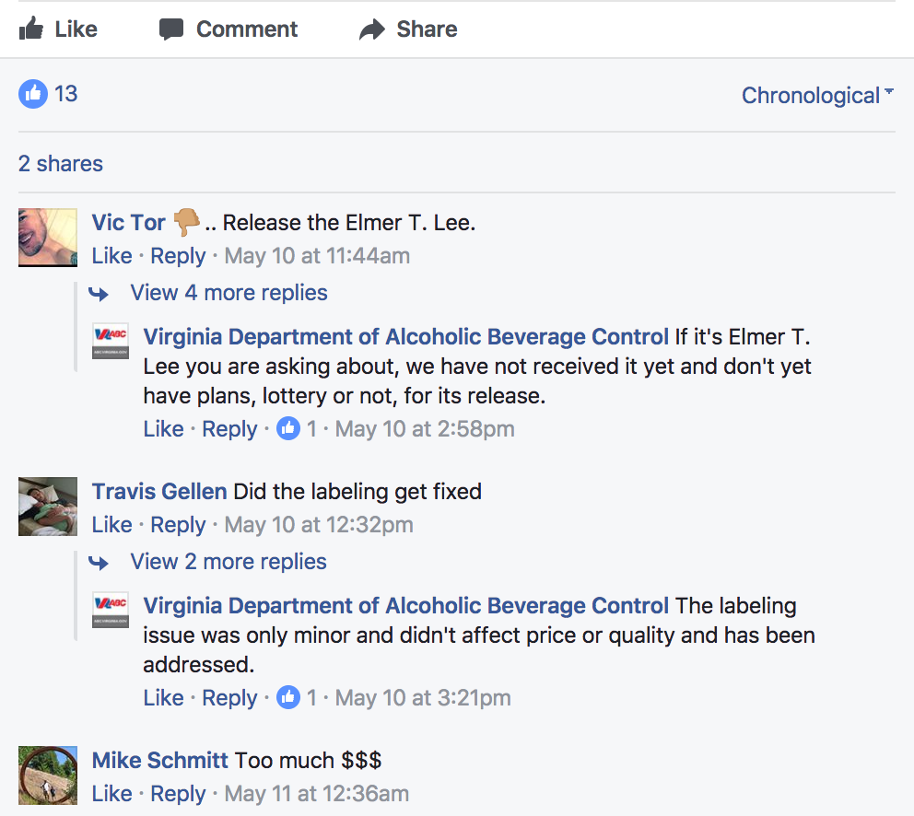
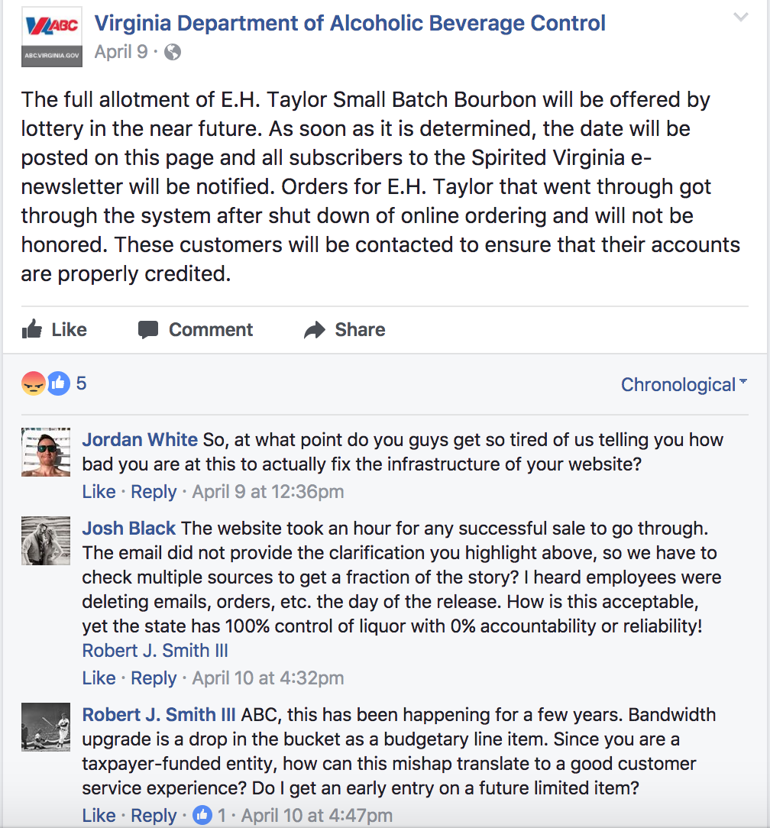
Very Little Engagement
The most engagement is on announcements of lotteries and limited availability
The majority of comments are questions or complaints about the system or item being offered
Source: Facebook Insights for Spirited Virginia

Slide 26
Key Consumer Decision Points

Slide 27
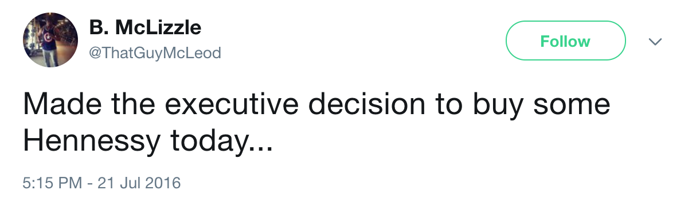
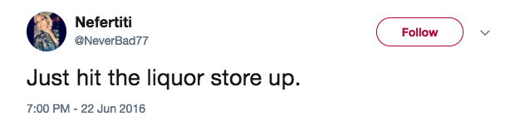
Anticipation
Preparation
Choosing Spirits
Purchase
Announcement
Know what to purchase
Have an idea but want to browse
Have no idea and need assistance
Notes:
Announcments - Add Instagram to announcement
Purchase – Faceboook complaints

Slide 28
Overall Insights
Anticipation and preparation are key points in the consumer decision for spirits
Consuming alcohol after long work days and stressful events is highlighted as a popular case
Personal storytelling is the reason behind posting
Consumers not only enjoy documenting their nights out, they also enjoy seeing/hearing about others’ too
Recipes resonate with consumers
Consumers are inspired to try new liquors/cocktails when they are given direction, and are excited to try new products
Consumers are proud of being “at-home” mixologists and put in the time to pose and post their creations
Current level of conversation about Virginia ABC specifically
Conversations that do exist are typically questions or complaints
Notes:
Removed Cultures
What is the perception of ABC as an institution - still need to speak to that
Insight – we didn’t find….
Pull in “greatest hits” screen shots

Slide 29
Appendix

Slide 30
Top 3 Selling Spirits in Virginia
Jack Daniel’s
Hennessy VS
Jim Beam
Source: Wise, S. (2016, Nov. 16) “Jack Daniels’s is the most popular liquor in Virginia.” Retrieved from http://wtvr.com/2016/11/10/jack-daniel-virginia/

Slide 31
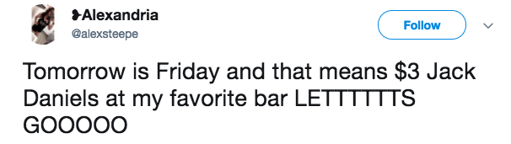
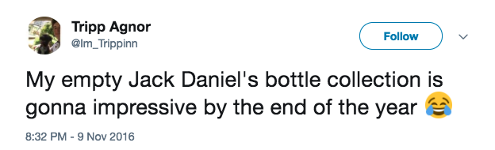

Jack Daniel’s
Rowdy and Rambunctious
Post Topics:
Local bar scene
Consumption amounts
Mixing with other beverages
Source: Sysomos

Slide 32



Hennessy
Night Life Professionals
Post Topics:
Nightclubs and parties
Debate on whether it actually tastes good or is consumed for the outward appearance
Pairing with chicken wings
Source: Sysomos

Slide 33



Laid Back & Satisfied
Laid Back and Satisfied
Post Topics:
Go-to whiskey
Consuming with family and friends
Proud American
Source: Sysomos

